Slide 2
Welcome To Year 11 GCSE Focus Evening

Slide 3
Mr Feltimo
Year Manager

Slide 4
Welcome & Introduction
Key Dates – 2021/22
Autumn Term Full Report – week beginning (wb) Monday 8 November 2021
Year 11 Pre Public Examinations (PPEs) – 29 November to 16 December 2021
Spring Term Progress and PPE Report – wb Monday 31 January 2022
Parents’ Evening – Thursday 31 March 2022
Provisional GCSE Timetable - Monday 16 May to Wednesday 22 June 2022
Year 11 Prom – Sunday 26 June 2022
GCSE Results Day – TBC (third Thursday in August? – 18 August?)

Slide 5
GCSE Target Grades – A Health Warning
Mr Rhodes

Slide 6
Student Targets for GCSE grades
Fischer Family Trust
The FFT provides benchmarks for each student of their likely future attainment.
It does this by using information from many thousands of students in the past and linking attainment at one age (e.g. GCSE results at 16) with attainment at a previous age (e.g. KS2 test results at 11).
It also takes into account gender and month of birth
At KS4, the FFT provides for each student the percentage chance of getting each grade for 20 GCSE subjects.

Slide 7
For example…………
Student A | 1 | 2 | 3 | 4 | 5 | 6 | 7 | 8 | 9
Target = 6 | 0 | 2 | 6 | 12 | 19 | 25 | 16 | 14 | 6
Chance (%)
Student B | 1 | 2 | 3 | 4 | 5 | 6 | 7 | 8 | 9
Target = 3 | 3 | 10 | 26 | 20 | 18 | 12 | 7 | 3 | 1
Chance (%)

Slide 8
Benchmarks are not prophecies.
Just because many students progressed from a particular KS2 score to a particular GCSE outcome doesn't mean that this student with their particular circumstances is destined to follow suit.
What did some students do to be different from the majority of other students just like them?
Why can’t that student be YOU?

Slide 9
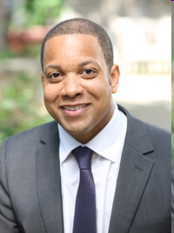
Do you know who this is?

Slide 10
Read each sentence below and decide how much you agree with it – there are no right or wrong answers
1) You have a certain amount of ability, and you really can’t do much to change it
1 – Strongly agree
2 – Agree
3 – Mostly agree
4 – Mostly disagree
5 – Disagree
6 – Strongly Disagree

Slide 11
Read each sentence below and decide how much you agree with it – there are no right or wrong answers
2) Your ability is something about you that you can’t change very much
1 – Strongly agree
2 – Agree
3 – Mostly agree
4 – Mostly disagree
5 – Disagree
6 – Strongly Disagree

Slide 12
Read each sentence below and decide how much you agree with it – there are no right or wrong answers
3) You can learn new things, but you can’t really change your basic intelligence
1 – Strongly agree
2 – Agree
3 – Mostly agree
4 – Mostly disagree
5 – Disagree
6 – Strongly Disagree

Slide 13
Calculating Your Mind-set
Add up your three scores to give a total out of 18
Divide by 3 to give an average score out of 6
Score 1 – 3 = Fixed Mind-set
Score 4 – 6 = Growth Mind-set

Slide 14
Fixed versus Growth Mind-Set
Theories of intelligence: | Fixed | Growth
Your belief: | Intelligence is a fixed trait | Intelligence is cultivated through learning
Your priority: | Look smart, not thick | Become smarter through learning
You feel smart when…. | Achieving easy, low effort successes and outperforming others | Engaging fully with new tasks, exerting effort, stretching and applying skills
You avoid: | Effort, difficulty, setbacks and high performing students | Easy, previously mastered tasks

Slide 15
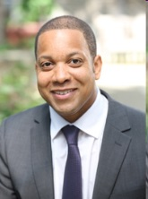
Dr Dean Fennell
Dean Fennell qualified with a first class degree in Pharmacology followed by Medicine and Surgery from University College London in 1993.
During this time he was awarded several prizes including the Schild Prize (Pharmacology) and the John Murray Scholarship & Medal (Clinical Pharmacology).
Basic specialist training in Medicine was completed at UCL, Hammersmith, Brompton, Guy’s and St Thomas’ Hospitals in London, and led to Membership of the Royal College of Physicians in 1996, followed by a PhD in Oncology as a Medical Research Council fellow, focusing on experimental cancer therapeutics and apoptosis sensitization.
In 2005, he was awarded a Cancer Research UK Clinician Scientist fellowship as a Consultant and Senior Lecturer in Medical Oncology, based at the Centre for Cancer Research and Cell Biology, Queen’s University Belfast
In 2007 Dr Fennell was elected a Fellow of the Royal College of Physicians (London), and in 2008, of the Royal College of Physicians of Ireland

Slide 16
My mate ‘Deano’ (Oxford City High School 1980 to 1985 - Russell House and in Set 4 of 7)
O-Levels (GCSEs)
Maths – C (4)
English – C (4) (E (2) first time)
Biology – C (4)
Chemistry – C (4)
Business Studies – C (4)
R.E. – D (3)
French – D (3)
German – E (2)
A-Levels
Chemistry – B
Biology – C
Maths – C
Economics - U

Slide 17
Myths and Mind-sets
A - “Some People are Born Smart”
versus
B - “Intelligence Develops Over Time”
A - “Smart Kids Learn Quickly and Easily”
Versus
B - “Working Hard Makes You Smart”

Slide 18
Managing work and stress levels
Mr Rhodes

Slide 19
Preparing to “STEP UP” to GCSEs
Notes:
Idea of ‘stepping up’ steps

Slide 20
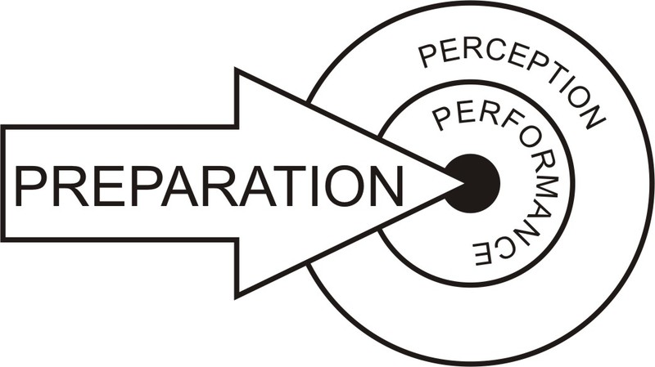
‘Prepare to Perform’

Slide 21
Some students’ responses to “stepping up” to GCSEs
“I’m stressed out”
“There’s too much to do, I don’t know where to start”
“I give up, I can’t concentrate”
“I can’t do this”
“I’m useless at …”
“This is too hard”

Slide 22
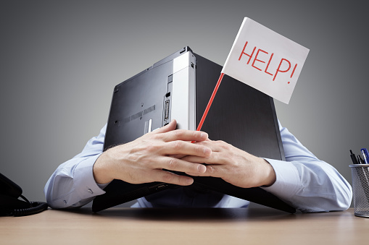
What is stress?
Stress is a state of mental or emotional strain or tension, caused by adverse or demanding circumstances.
Notes:
Staff could list some of the stresses that are current in their context, for example if mock examinations are coming up or certain deadlines etc. Staff may also consider wider stresses in their context, for example sporting competitions or theatre productions.

Slide 23
What factors contribute to stress?
Lifestyle: quality of rest, exercise, nutrition and time.
Information needs: exam strategies, plans and revision.
Psychological factors: feelings of control, the way we think of ourselves and the amount of pressure we put on ourselves.
Poor studying styles: binge studying, trying to memorise text books, inconsistent content coverage, all-night studying etc.

Slide 24
‘Anxiety’s like a rocking chair. It gives you something to do, but it doesn’t get you very far.’
Jodi Picoult

Slide 25
How can we stay calm and manage our anxiety levels?
‘Nothing diminishes anxiety faster than action.’ Walter Anderson
.
Notes:
Staff could share with students an anecdote of a time that stress became too much for them and how this affected them.

Slide 26
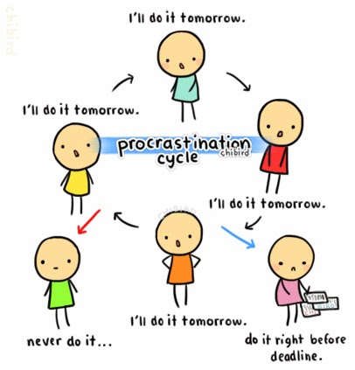
Make a start
Stay on top of the ‘learning’ stage
More time for the ‘applying’ stage
“ If I start now I’ll forget it, so I might as well start nearer the exam”
Replace with
‘slow and steady wins the race’
Notes:
Do TWO minutes of the task you are putting off
That’s all just two minutes – use a timer if you like
Why does it work?
The brain hates incomplete tasks
So once you start something for two minutes, you’ll often find yourself happily continuing with it until it’s done!

Slide 27
Sort out any questions you have as you go along
Avoid causing anxiety
Take action, see your teacher
“I feel silly asking, my friends will think I’m a geek”

Slide 28
Build up your level of concentration gradually Mental discipline
Plan your study time and rest time
Start small; minutes, task, frequency.
Build to 45 minutes then break
Every time I lost focus, I tried to re-focus again. I forced myself to sit there and keep re-focussing. After a while I saw my attention span start to increase
I give up, I can’t concentrate
“After a while I started to see that I enjoyed studying,
Being able to focus made me want to do more”.

Slide 29
Avoid distractions from technology
‘I would put my phone in another room so I would not be tempted to check it
I can’t not have my ‘phone.

Slide 30
Do Sport / Exercise
Improves your concentration
Boosts your memory
Helps reduce stress
Lengthens attention span
Red areas are very active; Blue areas are least active

Slide 31
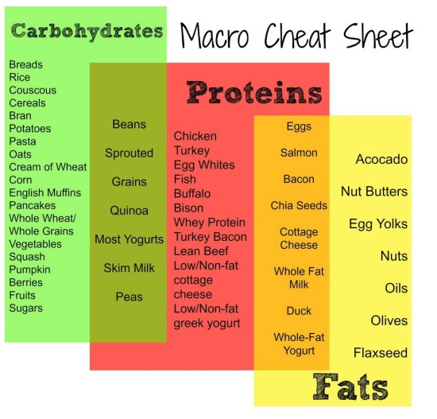
Look at your diet : Energy boosting Foods
A BALANCING ACT
Keep your sugar levels under control
UP THE B’S
B vitamins are directly involved in creating energy at a cellular level & will give you an energy boost
Green vegetables
Asparagus / Spinach
Broccoli
Yoghurt
Chicken / Turkey / Salmon
Whole Grains / Brown rice
Almonds / Pecans
Eggs
MIGHTY MAGNESIUM
Magnesium is involved in over 1000 enzymatic reactions in the body. It's vitally important in providing our cells with energy
Green vegetables
Nuts
Pulses
Fish
Bananas

Slide 32
One of the best ways to maximise your focus is to stay hydrated
Look at your diet : Stay hydrated
“
Even mild dehydration can lead to tiredness, headaches, reduced alertness and diminished concentration
”

Slide 33
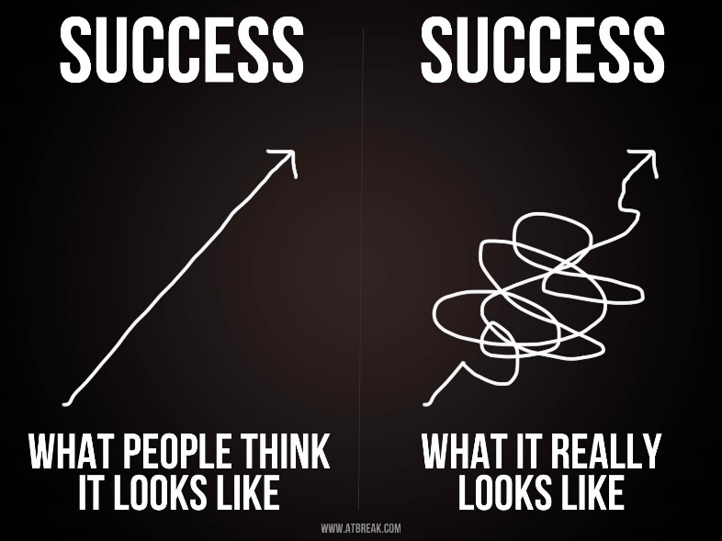
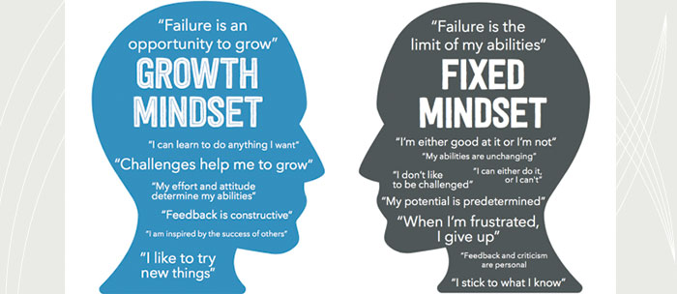
Resilience
We can all grow
I’m useless at ….

Slide 34
Study Skills
Mr Rhodes

Slide 35
Study Skills (not Revision Skills)
Note Taking
Colour for importance
Red for very important
Blue for important
Green for quite important
Colour to distinguish between sections of a topic
Orange for one section
Pink for another section

Slide 36
RAG Rating
Colour coding a syllabus or scheme of work
Red – still very unsure
Amber – making progress but some areas of confusion
Green – very confident, clear understanding
And then……
Focus on the Red areas

Slide 37
Key Words
Key Words | Sentences
 | There are two types of limited company: Public limited companies (PLC); and Private limited companies (Ltd)
 | To set up a public limited company or a private limited company, a minimum of two shareholders is needed
 | A limited company is owned by its shareholders, but managed by its directors
 | The accounts of limited companies have to be audited – checked for accuracy and truthfulness – by external auditors

Slide 38
Key Words
Key Words | Sentences
PLC Ltd | There are two types of limited company: Public limited companies (PLC); and Private limited companies (Ltd)
TWO shareholders | To set up a public limited company or a private limited company, a minimum of two shareholders is needed
Owners = shareholders Managers = Directors | A limited company is owned by its shareholders, but managed by its directors
Audited Accounts | The accounts of limited companies have to be audited – checked for accuracy and truthfulness – by external auditors

Slide 39
Key Words
Key Words | Sentences
PLC Ltd
TWO shareholders
Owners = shareholders Managers = Directors
Audited Accounts

Slide 40
Note-Taking Techniques
Life of Princess Diana
 | Born on 1st July 1961
 | Parents separated in 1967
 | Moved to her family’s stately home (Althorp) in 1975
 | Married Prince Charles in 1981
 | Prince William was born in 1982
 | Prince Harry was born in 1984
 | Announced separation from Prince Charles in 1992
 | Tragically dies in a car crash in Paris in 1997

Slide 41
Note-Taking Techniques
Life of Princess Diana
1/7/61 | Born on 1st July 1961
< Parents 67 > | Parents separated in 1967
Althorp 75 | Moved to her family’s stately home (Althorp) in 1975
Married 81 | Married Prince Charles in 1981
W82 | Prince William was born in 1982
H84 | Prince Harry was born in 1984
< Charles 92 > | Announced separation from Prince Charles in 1992
RIP 97 | Tragically dies in a car crash in Paris in 1997

Slide 42
Memory Techniques - Mnemonics
My Very Educated Mother Just Served Us Nine Potatoes
(Order of the planets from the sun)
All Boys Should Come Home Please
(Wives of Henry VIII names: Aragon, Boleyn, Seymour, Cleves, Howard, Parr)
May I have a large container of coffee?
(The number of letters in each word equals the numerals in pi = 3.1415927)
Dashing In A Rush, Running Harder (or) Else Accident!
Correct spelling of Diarrhoea!!

Slide 43
Memory Techniques - Mnemonics
Give yourself 30 seconds to memorise the 15 words listed below and then tell your partner as many as you can remember
Airport | Blanket | Flags | Monk | Cafe | Dragon | Ice
Skull | Tea | Cards | Book | Shell | Crystal | Teeth

Slide 44
Memory Techniques - Mnemonics
Give yourself 30 seconds to memorise the 15 words listed below and then tell your partner as many as you can remember

Slide 45
Memory Techniques - Mnemonics
Give yourself 30 seconds to memorise the 15 words listed below and then tell your partner as many as you can remember
Airport | Blanket | Flags | Monk | Cafe | Dragon | Ice
Skull | Tea | Cards | Book | Shell | Crystal | Teeth

Slide 46
Memory Techniques - Mnemonics
Imagine that you wake-up at an airport wrapped in a blanket that is made of flags. An old monk comes over and quietly whispers that you should go to the cafe upstairs to meet your friends. When you arrive at the café there is a foul smelling dragon sitting on a block of ice and opposite him is a beautiful girl sitting on a giant skull. They are drinking tea and playing cards. Suddenly the girl throws a card at you which, when you catch it, transforms into a little book. You look up again but the dragon and the girl have vanished. All that is left at their table is a shell full of crystal teeth.

Slide 47
Memory Techniques - Mnemonics
Airport | Blanket | Flags | Monk | Cafe | Dragon | Ice
Skull | Tea | Cards | Book | Shell | Crystal | Teeth

Slide 48
Using Mnemonics Effectively
Five principles to apply when creating mnemonics
SOLAR
Symbols – which flag did you see?
Outstanding – old monk and a dragon
Links – the card that became a book
All five senses – the sound of the monk, the smell of the dragon and the sight of the crystal teeth
Repetition – go back over the story multiple times

Slide 49
Example
The Wall Street Crash – some of the main events
There was a high demand for US goods after the First World War
Certain US industries (e.g. the motor industry) grew rapidly in the early 1920s
The US economy started to decline in the late 1920s
Panic-selling led to the Wall Street Crash in 1929
US banks and companies were forced to close
Widespread poverty resulted, because many people lost their jobs and their savings

Slide 50
We need an anchor symbol…….
The US Flag
Imagine that a man grabs a US flag (high demand for American goods) and he sticks it on the top of his huge car (growth of motor industry).
He then climbs into a much smaller car (decline of the US economy) and drives off.
He passes through a market where everyone is frantically trying to sell things (panic-selling) and hears a huge explosion (the Wall Street Crash)
The man arrives in a town where every shop is closed (banks and companies forced to close) and gives his car to a beggar on the roadside (widespread poverty)

Slide 51
We need an anchor symbol…….
The US Flag
Imagine that a man grabs a US flag (high demand for American goods) and he sticks it on the top of his huge car (growth of motor industry).
He then climbs into a much smaller car (decline of the US economy) and drives off.
He passes through a market where everyone is frantically trying to sell things (panic-selling) and hears a huge explosion (the Wall Street Crash)
The man arrives in a town where every shop is closed (banks and companies forced to close) and gives his car to a beggar on the roadside (widespread poverty)

Slide 52
Are you ready?
Mr Rhodes

Slide 53
GCSE Checklist – Religious Studies
How many of the following questions can you answer ‘yes’?
Do you know which examination board you are studying for RS?
Have you saved the examination board website to your favourites?
Do you have a copy of the specification/syllabus?
Do you know how you will be examined and what you will be examined on?

Slide 54
GCSE Checklist – Religious Studies
What do you know about the RS examinations?
How many papers will you take at the end of Year 11?
How are the papers different?
How many marks are on offer for each paper?
What type of questions will be in each paper?
Do you know how to obtain full marks for a 2, 4, 5 and 12 mark question?
How are these questions different?
Do you score marks for Spelling, Punctuation and Grammar? If so, how many marks and on which questions?

Slide 55
On the way home……
Please decide…..
What 3 things are you going to action right now (or a at least tomorrow morning!)?
What can you start right now that will have the biggest impact on your learning and attainment?
Record these three items on your phone in the notes section
Make sure this is done before you go to bed!!

